Slide 1
Intro to Cloud Computing CS4037 (BCS-6A) Lecture 11
Danyal Farhat
FAST School of Computing
NUCES Lahore

Slide 2
Module 6: Compute
AWS Academy Cloud Foundations

Slide 3

Lab 3: Introduction to Amazon EC2

Slide 4





Lab 3 scenario
In this lab, you will launch and configure your first virtual machine that runs on Amazon EC2.
AWS Cloud
Region
Availability Zone 1
Lab VPC
Public subnet
Web server instance

Slide 5
Lab 3: Tasks
Task 1 – Launch Your Amazon EC2 Instance
Task 2 – Monitor Your Instance
Task 3 – Update Your Security Group and Access the Web Server
Task 4 – Resize Your Instance: Instance Type and EBS Volume
Task 5 – Explore EC2 Limits
Task 6 – Test Termination Protection

Slide 6


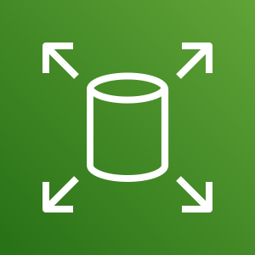

Lab 3: Final product
By the end of the lab, you will have:
Launched an instance that is configured as a web server
Viewed the instance system log
Reconfigured a security group
Modified the instance type and root volume size
Amazon EC2
VPC
AMI
Security group
t2.micro
instance
t2.small
instance
Amazon Elastic Block Store (Amazon EBS)
8-GB root volume
10-GB root volume

Slide 7


Begin Lab 3: Introduction to Amazon EC2
~ 35 minutes

Slide 8
Deployment vs Managed Services
Between Amazon EC2 or Amazon RDS, which provides a managed service? What does managed service mean?
ANSWER: Amazon RDS provides a managed service. Amazon RDS handles provisioning, installation and patching, automated backups, restoring snapshots from points in time, high availability, and monitoring.
Name at least one advantage of deploying Microsoft SQL Server on Amazon EC2 instead of Amazon RDS.
ANSWER: Amazon EC2 offers complete control over every configuration, the OS, and the software stack.
What advantage does the Quick Start provide over a manual installation on Amazon EC2?
ANSWER: The Quick Start is a reference architecture with proven best practices built into the design.
Which deployment option offers the best approach for all use cases?
ANSWER: Neither. The correct deployment option depends on your specific needs.
Which approach costs more: using Amazon EC2 or using Amazon RDS?
ANSWER: It depends. Managing the database deployment on Amazon EC2 requires more customer oversight and time. If time is your priority, then Amazon RDS might be less expensive. If you have in-house expertise, Amazon EC2 might be more cost-effective.

Slide 9
Section 3: Amazon EC2 cost optimization
Module 6: Compute

Slide 10
Amazon EC2 pricing models
On-Demand Instances
Pay by the hour
No long-term commitments.
Eligible for the AWS Free Tier.
Dedicated Hosts
A physical server with EC2 instance capacity fully dedicated to your use.
Dedicated Instances
Instances that run in a VPC on hardware that is dedicated to a single customer.
Reserved Instances
Full, partial, or no upfront payment for instance you reserve.
Discount on hourly charge for that instance.
1-year or 3-year term.
Scheduled Reserved Instances
Purchase a capacity reservation that is always available on a recurring schedule you specify.
1-year term.
Spot Instances
Instances run as long as they are available and your bid is above the Spot Instance price.
They can be interrupted by AWS with a 2-minute notification.
Interruption options include terminated, stopped or hibernated.
Prices can be significantly less expensive compared to On-Demand Instances
Good choice when you have flexibility in when your applications can run.
Per second billing available for On-Demand Instances, Reserved Instances, and
Spot Instances that run Amazon Linux or Ubuntu.

Slide 11
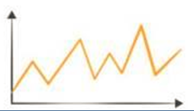
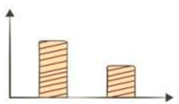
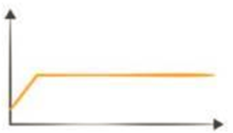
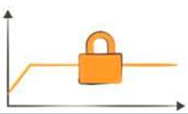
Amazon EC2 pricing models: Benefits
On-Demand Instances | Spot Instances | Reserved Instances | Dedicated Hosts
Low cost and flexibility | Large scale, dynamic workload | Predictability ensures compute capacity is available when needed | Save money on licensing costs Help meet compliance and regulatory requirements

Slide 12
Amazon EC2 pricing models: Use cases
Spiky Workloads
Time-Insensitive Workloads
Steady-State Workloads
Highly Sensitive Workloads
On-Demand Instances | Spot Instances | Reserved Instances | Dedicated Hosts
Short-term, spiky, or unpredictable workloads Application development or testing | Applications with flexible start and end times Applications only feasible at very low compute prices Users with urgent computing needs for large amounts of additional capacity | Steady state or predictable usage workloads Applications that require reserved capacity, including disaster recovery Users able to make upfront payments to reduce total computing costs even further | Bring your own license (BYOL) Compliance and regulatory restrictions Usage and licensing tracking Control instance placement

Slide 13

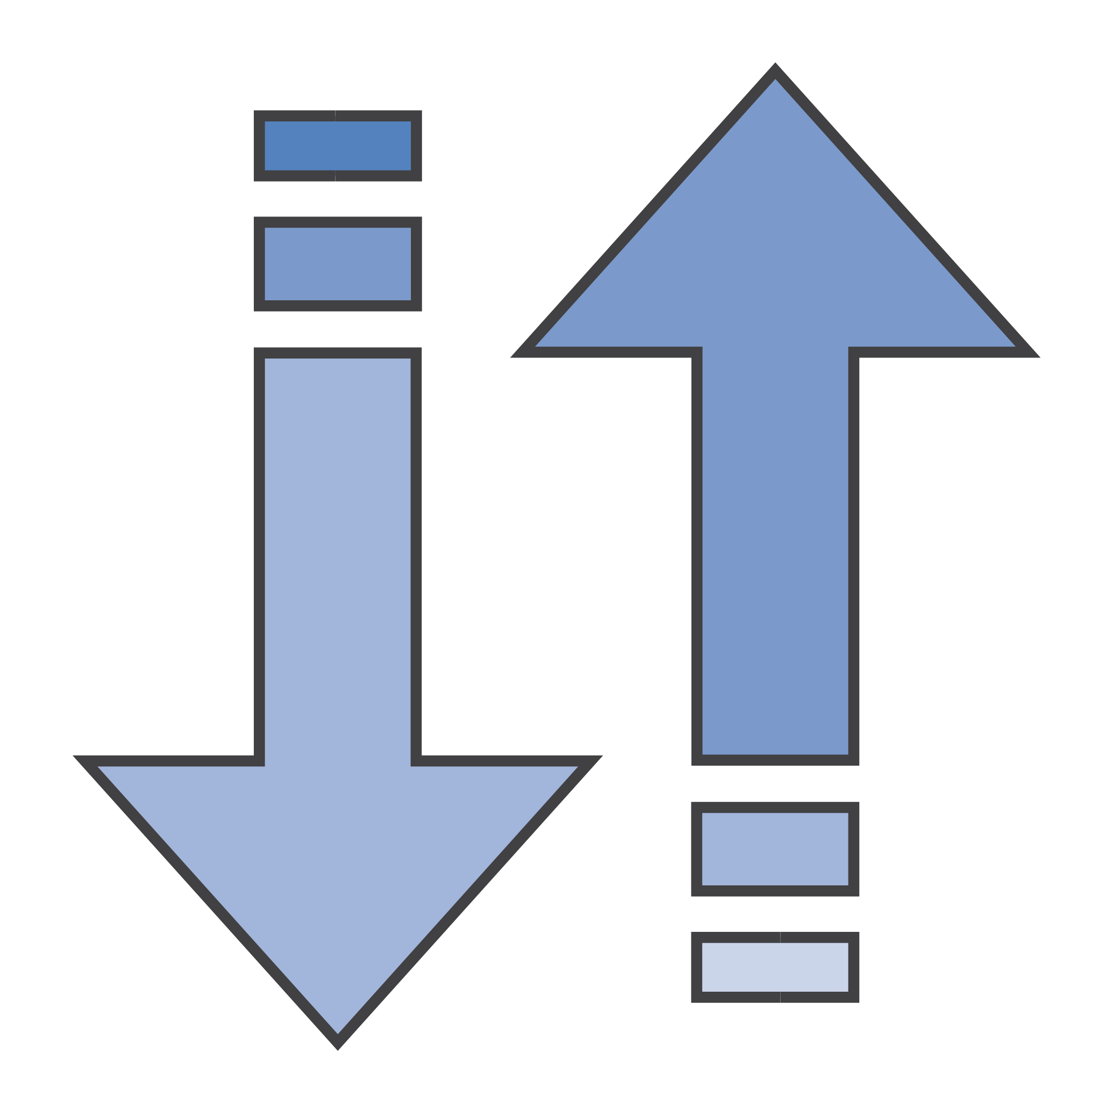



The four pillars of cost optimization
Cost Optimization
Increase elasticity
Optimal pricing model
Optimize storage choices
Right size

Slide 14
Pillar 1: Right size
AWS offers approximately 60 instance types and sizes
Provision instances to match the need
CPU, memory, storage, and network throughput
Select appropriate instance types for your use
Use Amazon CloudWatch metrics
How idle are instances? When?
Downsize instances
Best practice: Right size, then reserve
Pillars:

1. Right size
2. Increase elasticity
3. Optimal pricing model
4. Optimize storage choices


Slide 15
Pillar 2: Increase elasticity
Stop or hibernate Amazon EBS-backed instances that are not actively in use
Example: non-production development or test instances
Use automatic scaling to match needs based on usage
Automated and time-based elasticity
Pillars:
1. Right-Size
2. Increase Elasticity
3. Optimal pricing model
4. Optimize storage choices



Slide 16
Pillar 3: Optimal pricing model
Leverage the right pricing model for your use case
Consider your usage patterns
Optimize and combine purchase types
Examples:
Use On-Demand Instance and Spot Instances for variable workloads
Use Reserved Instances for predictable workloads
Consider serverless solutions (AWS Lambda)
Pillars:
1. Right-Size
2. Increase Elasticity
3. Optimal pricing model
4. Optimize storage choices



Slide 17
Pillar 4: Optimize storage choices
Reduce costs while maintaining storage performance and availability
Resize EBS volumes
Change EBS volume types
Can you meet performance requirements with less expensive storage?
Example: Amazon EBS Throughput Optimized HDD (st1) storage typically costs half as much as the default General Purpose SSD (gp2) storage option.
Delete EBS snapshots that are no longer needed
Identify the most appropriate destination for specific types of data
Does the application need the instance to reside on Amazon EBS?
Amazon S3 storage options with lifecycle policies can reduce costs
Pillars:
1. Right-Size
2. Increase Elasticity
3. Optimal pricing model
4. Optimize storage choices



Slide 18




Measure, monitor, and improve
Cost optimization is an ongoing process.
Recommendations –
Define and enforce cost allocation tagging.
Define metrics, set targets, and review regularly.
Encourage teams to architect for cost.
Assign the responsibility of optimization to an individual or to a team.
Use of AWS Trusted Advisor can help to reduce cost.

Slide 19

Section 3 key takeaways
Amazon EC2 pricing models include On-Demand Instances, Reserved Instances, Spot Instances, Dedicated Instances, and Dedicated Hosts.
Spot Instances can be interrupted with a 2-minute notification. However, they can offer significant cost savings over On-Demand Instances.
The four pillars of cost optimization are:
Right size
Increase elasticity
Optimal pricing model
Optimize storage choices

Slide 20
Section 4: Container services
Module 6: Compute

Slide 21
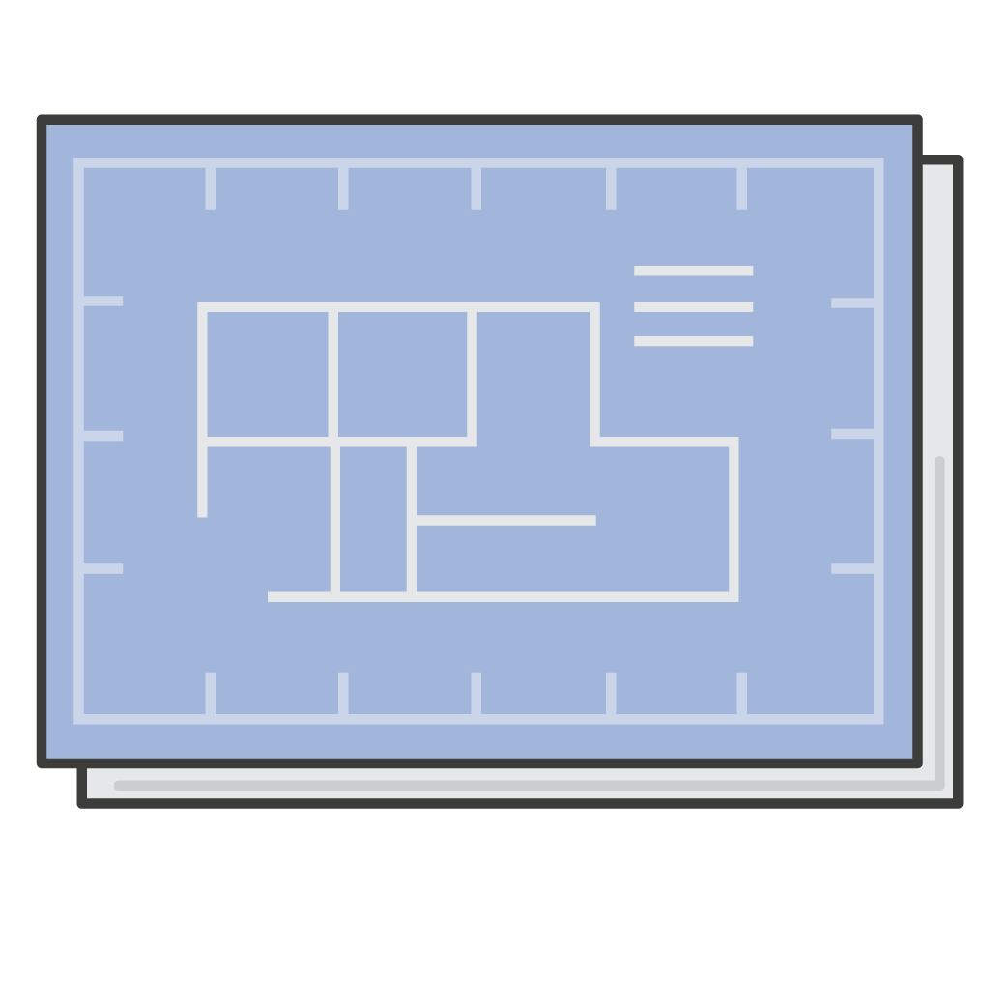

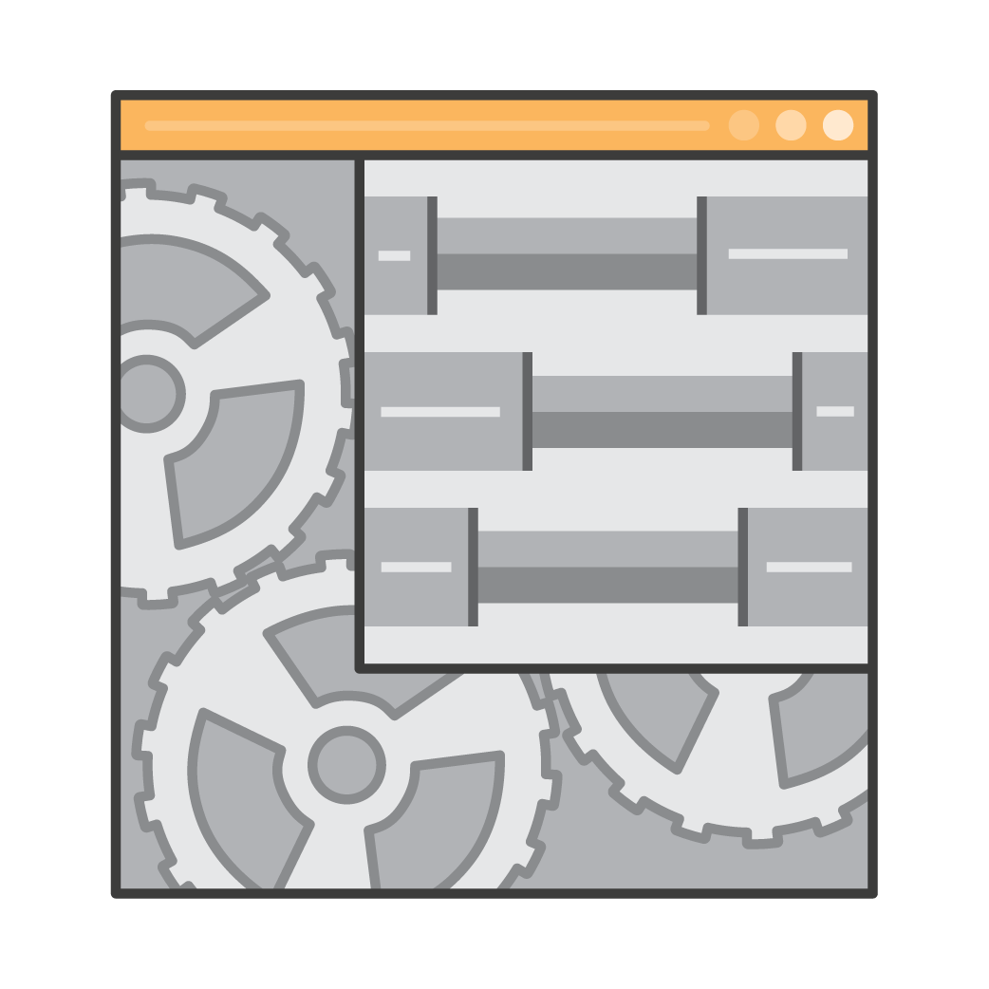
Container basics
Containers are a method of operating system virtualization.
Benefits –
Repeatable.
Self-contained environments.
Software runs the same in different environments.
Developer's laptop, test, production.
Faster to launch and stop or terminate than virtual machines
Your Container
Your application
Dependencies
Configurations
Hooks into OS

Slide 22

What is Docker?
Docker is a software platform that enables you to build, test, and deploy applications quickly.
Docker packages software (such as applications) into containers.
Docker is installed on each server that will host containers.
You run containers on Docker.
Containers are created from a template called an image.
A container has everything a software application needs to run.
Container
Containers have everything the software needs to run:
Libraries
System tools
Code
Runtime

Slide 23
What is Docker?
Docker is best used as a solution when you want to:
Standardize environments
Reduce conflicts between language stacks and versions
Use containers as a service
Run microservices using standardized code deployments
Require portability for data processing
Container
Containers have everything the software needs to run:
Libraries
System tools
Code
Runtime

Slide 24
Containers versus virtual machines
Three virtual machines on three EC2 instances
Example
VM 1
VM 2
VM 3
Three containers on one EC2 instance
Container
App 1
App 2
App 3
Container instance 1
Container instance 2
Container instance 3
Bins/Libs
Bins/Libs
Bins/Libs
Docker engine
App 1
App 2
App 3
EC2 instance guest OS
EC2 instance guest OS
EC2 instance guest OS
Bins/Libs
Bins/Libs
Bins/Libs
EC2 instance guest OS
Hypervisor
Part of AWS Global Infrastructure
Host operating system
Physical server

Slide 25

Amazon Elastic Container Service (Amazon ECS)
Amazon Elastic Container Service (Amazon ECS) –
A highly scalable, fast, container management service
Key benefits –
Orchestrates the running of Docker containers
Maintains and scales the fleet of nodes that run your containers
Removes the complexity of standing up the infrastructure
Integrated with features that are familiar to Amazon EC2 service users –
Elastic Load Balancing
Amazon EC2 security groups
Amazon EBS volumes
IAM roles
Amazon Elastic Container Service

Slide 26
Amazon Elastic Container Service (Amazon ECS)
Essential Amazon ECS features include the ability to:
Launch up to tens of thousands of Docker containers in seconds
Monitor container deployment
Manage the state of the cluster that runs the containers
Schedule containers by using a built-in scheduler or a third-party scheduler (for example, Apache Mesos or Blox)
Amazon ECS clusters can also use Spot Instances and Reserved Instances.
Amazon Elastic Container Service

Slide 27

Amazon ECS orchestrates containers
EC2 instance
Requests to run containers
x3
x2
Container A
EC2 instance
Container B
Amazon Elastic Container Service (Amazon ECS)
ECS cluster

Slide 28
Amazon ECS cluster options
Key question: Do you want to manage the Amazon ECS cluster that runs the containers?
If yes, create an Amazon ECS cluster backed by Amazon EC2 (provides more granular control over infrastructure)
If no, create an Amazon ECS cluster backed by AWS Fargate (easier to maintain, focus on your applications)
Containers
Amazon ECS cluster backed by Amazon EC2
Amazon ECS cluster backed by Fargate
Container instance 1
Container instance 2
Container instance 3
App 1
App 2
App 3
You manage
Bins/Libs
Bins/Libs
Bins/Libs
You manage
Docker engines (one per OS in the cluster)
AWS manages
VM guest operating systems in the Amazon ECS cluster

Slide 29
Amazon ECS cluster options
When you create an Amazon ECS cluster, you have three options:
A Networking Only cluster (powered by AWS Fargate)
An EC2 Linux + Networking cluster
An EC2 Windows + Networking cluster
Containers
Amazon ECS cluster backed by Amazon EC2
Amazon ECS cluster backed by Fargate
Container instance 1
Container instance 2
Container instance 3
App 1
App 2
App 3
You manage
Bins/Libs
Bins/Libs
Bins/Libs
You manage
Docker engines (one per OS in the cluster)
AWS manages
VM guest operating systems in the Amazon ECS cluster

Slide 30
What is Kubernetes?
Kubernetes is open source software for container orchestration.
Deploy and manage containerized applications at scale.
The same toolset can be used on premises and in the cloud.
Complements Docker.
Docker enables you to run multiple containers on a single OS host.
Kubernetes orchestrates multiple Docker hosts (nodes).
Automates –
Container provisioning.
Networking.
Load distribution.
Scaling.

Slide 31
What is Kubernetes?
Kubernetes manages a cluster of compute instances (called nodes).
It runs containers on the cluster, which are based on where compute resources are available and the resource requirements of each container.
Containers are run in logical groupings called pods.
You can run and scale one or many containers together as a pod.
Each pod is given an IP address and a single Domain Name System (DNS) name, which Kubernetes uses to connect your services with each other and external traffic.

Slide 32
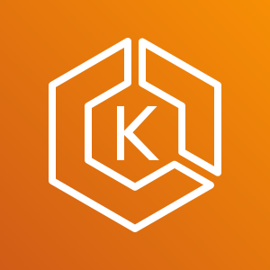
Amazon Elastic Kubernetes Service (Amazon EKS)
Amazon Elastic Kubernetes Service (Amazon EKS)
Enables you to run Kubernetes on AWS
Certified Kubernetes conformant (supports easy migration)
Supports Linux and Windows containers
Compatible with Kubernetes community tools and supports popular Kubernetes add-ons
Use Amazon EKS to –
Manage clusters of Amazon EC2 compute instances
Run containers that are orchestrated by Kubernetes on those instances
Amazon Elastic Kubernetes Service

Slide 33



Amazon Elastic Container Registry (Amazon ECR)
Amazon ECR is a fully managed Docker container registry that makes it easy for developers to store, manage, and deploy Docker container images.
Amazon ECS integration
Docker support
Team collaboration
Access control
Third-party integrations
Amazon Elastic Container Registry
Image
Registry

Slide 34
Section 4 key takeaways
Containers can hold everything that an application needs to run.
Docker is a software platform that packages software into containers.
A single application can span multiple containers.
Amazon Elastic Container Service (Amazon ECS) orchestrates the running of Docker containers.
Kubernetes is open source software for container orchestration.
Amazon Elastic Kubernetes Service (Amazon EKS) enables you to run Kubernetes on AWS
Amazon Elastic Container Registry (Amazon ECR) enables you to store, manage, and deploy your Docker containers.

Slide 35
Thank you
All trademarks are the property of their owners.
Notes:
Thank you for completing this module.

